Slide 1

*metrics Project Summary and Outlook
*metrics in Transition - Final Workshop
27-28 March 2019
SUB Göttingen
Astrid Orth

Slide 2
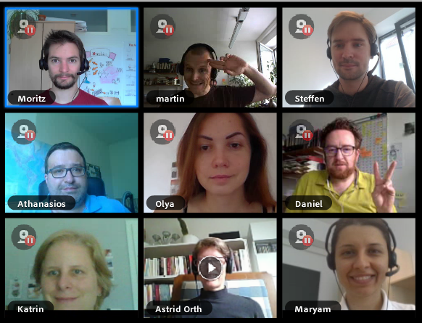
*metrics Project
DFG-funded 01/2017 – 05/2019
Partner
State and University Library Göttingen (SUB),
Leibniz-Informationszentrum Wirtschaft (ZBW)
Common Library Network (VZG) of the German States Bremen, Hamburg, Mecklenburg-Vorpommern, Niedersachsen, Sachsen-Anhalt, Schleswig-Holstein, Thüringen and the Foundation of Prussian Cultural Heritage
Leibniz Institute for the Social Sciences (GESIS)

Slide 3
*metrics Project Aims
MEasuring The Reliability and perceptions of Indicators for interactions with sCientific productS
Understanding of *metrics, especially in terms of their general significance and their perception amongst stakeholders
How can alternative metrics contribute to a new set of indicators for scientific output?

Slide 4
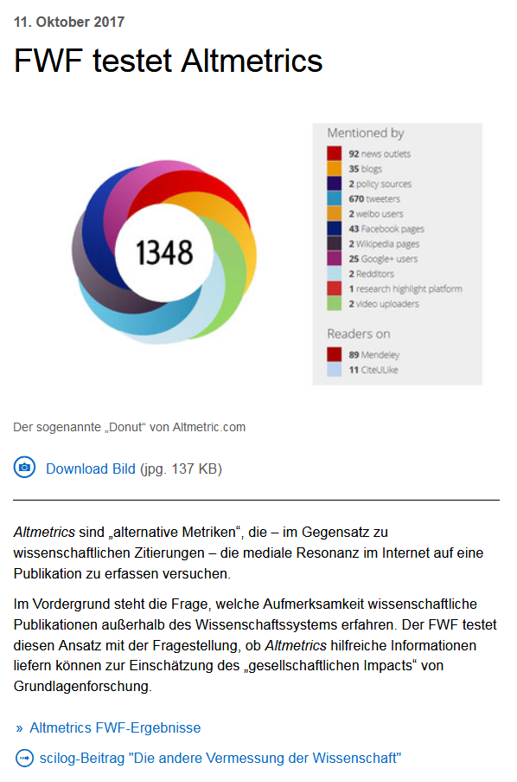
FWF is testing Altmetrics
Response to research contributions in (parts of) society
May prove “Societal Impact”
Altmetrics have weaknesses, but show also potential

Slide 5
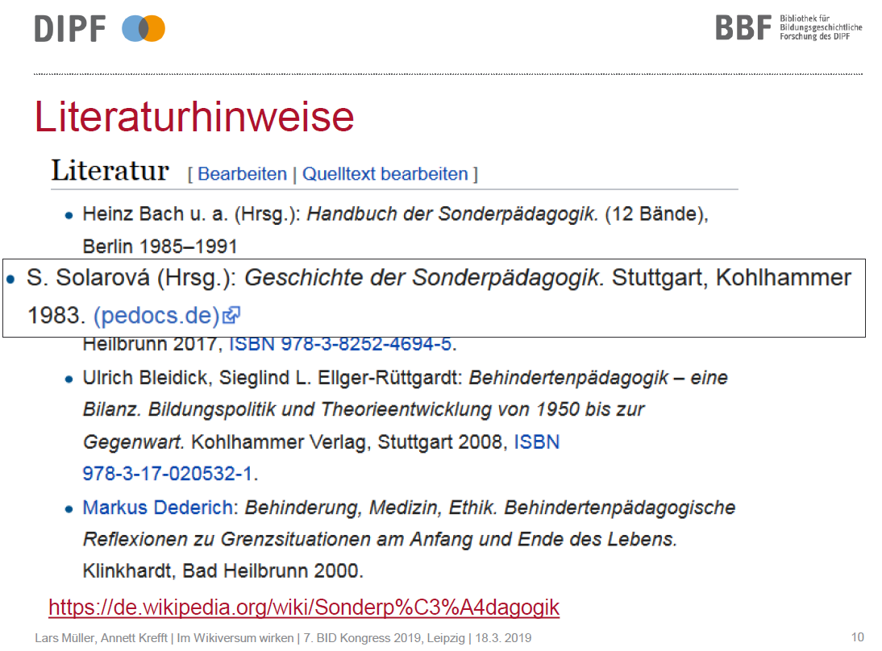
DIPF – Wikiversum project
How to measure Wikipedia impact?
Wikipedia usage can be detected
Comparable between repositories and over time
Serve as additional future performance indicator?

Slide 6
Integration in repositories
ZBW: EconStor
SUB: GoeScholar/GRO
GESIS: SSOAR
VZG: Embedding in repository software

Slide 7
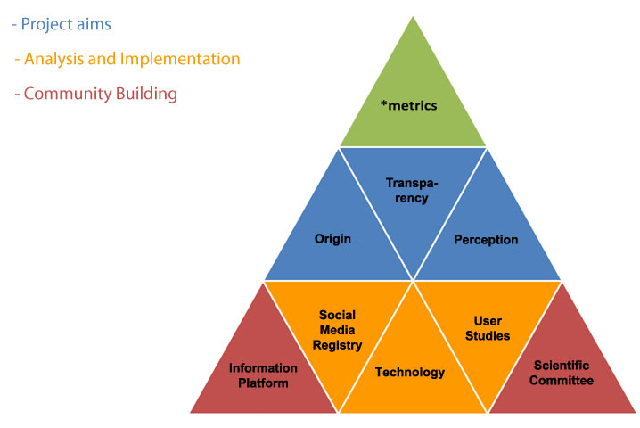
*metrics Project Structure
http://metrics-project.net

Slide 8
Findings

Slide 9
Recommendations

Slide 10
Questions?

Slide 11
Thank you / Vielen Dank!
Web metrics-project.net
E-Mail metrics-project@sub.uni-goettingen.de
Twitter @metrics_project
Facebook @metricsproject

